Slide 1
Probabilistic Models for Supervised Learning(2): Logistic and Softmax Regression
CS771: Introduction to Machine Learning
Piyush Rai

Slide 2

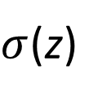
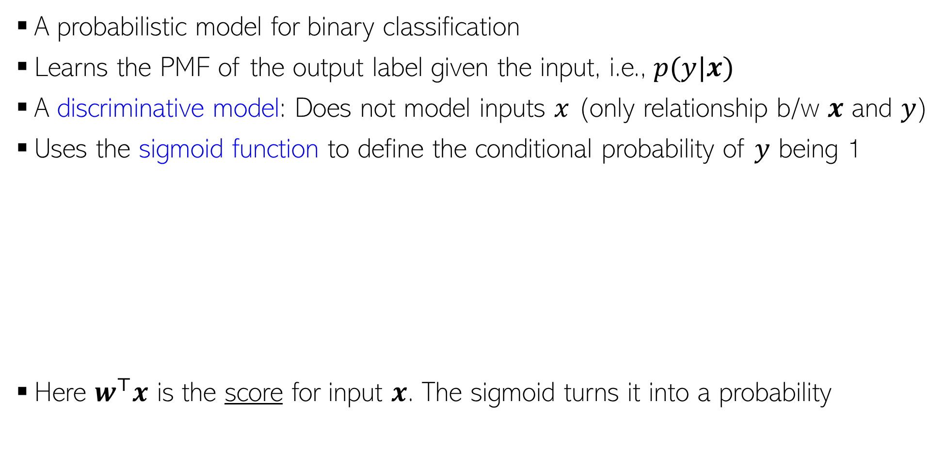

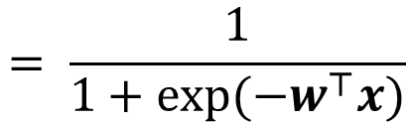


Logistic Regression (LR)
Both very widely used
Multi-class extension known as “softmax regression”
The word “regression” is a misnomer. Both are classification models
A probabilistic model for binary classification
Learns the PMF of the output label given the input, i.e., $p(y|x)$
A discriminative model: Does not model inputs $x$ (only relationship b/w $x$ and $y$)
Uses the sigmoid function to define the conditional probability of $y$ being 1
Here $w^{⊤}x$ is the score for input $x$. The sigmoid turns it into a probability
$$μ_{x}=p\left(y=1 | w,x\right)=σ(w^{⊤}x)$$
$σ$(z)
1
$$= \frac{1}{1+exp(−w^{⊤}x)}$$
0.5
$$= \frac{exp(w^{⊤}x)}{1+exp(w^{⊤}x)}$$
A linear model
0
$$\text{z}$$

Slide 3
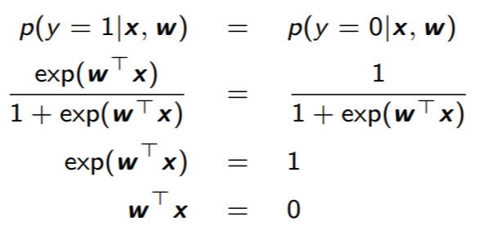
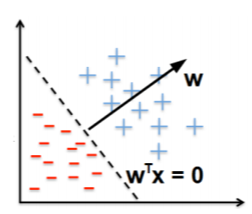

LR: Decision Boundary
At the decision boundary where both classes are equiprobable
Very large positive $w^{⊤}x$ means $p\left(y=1 | w,x\right)$ close to 1
Very large negative $w^{⊤}x$ means $p\left(y=0 | w,x\right)$ close to 1
At decision boundary, $w^{⊤}x$ = 0 implies $p\left(y=1 | w,x\right)$ = $p\left(y=0 | w,x\right)$ = 0.5
A linear hyperplane

Slide 4
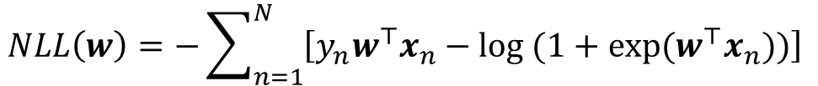

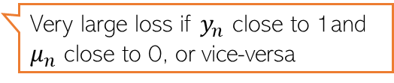
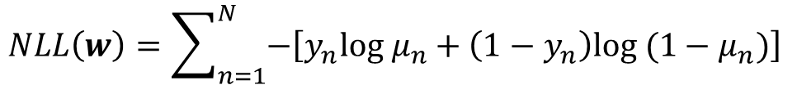
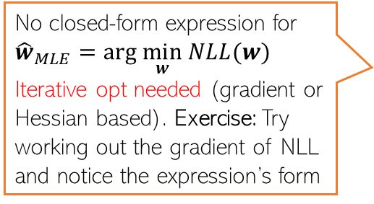
MLE for Logistic Regression
Assumed 0/1, not -1/+1
Likelihood (PMF of each input’s label) is Bernoulli with prob $μ_{n}=\frac{exp(w^{⊤}x_{n})}{1+exp(w^{⊤}x_{n})}$
Overall likelihood, assuming i.i.d. observations
The negative log-likelihood $NLL\left(w\right)=−log p\left(y | w,X\right)$ simplifies to
Plugging in $μ_{n}=\frac{exp(w^{⊤}x_{n})}{1+exp(w^{⊤}x_{n})}$ and simplifying
$$p\left(y_{n} | w,x_{n}\right)=Bernoulli\left(μ_{n}\right)=μ_{n}^{y_{n}}{(1−μ_{n})}^{1−y_{n}}$$
$$p\left(y | w,X\right)=\prod_{n=1}^{N}{p\left(y_{n} | w,x_{n}\right)=\prod_{n=1}^{N}{μ_{n}^{y_{n}}{(1−μ_{n})}^{1−y_{n}}}}$$
“cross-entropy” loss (a popular loss function for classification)
Loss function
$$NLL\left(w\right)=\sum_{n=1}^{N}{−\left[y_{n}log μ_{n}+\left(1−y_{n}\right)log (1−μ_{n})\right]}$$
Very large loss if $y_{n}$ close to 1and $μ_{n}$ close to 0, or vice-versa
Good news: For LR, NLL is convex
No closed-form expression for ${\hat{w}}_{MLE}=arg \min_{w} NLL(w)$
Iterative opt needed (gradient or Hessian based). Exercise: Try working out the gradient of NLL and notice the expression’s form
$$NLL\left(w\right)=−\sum_{n=1}^{N}{\left[y_{n}w^{⊤}x_{n}−log (1+exp(w^{⊤}x_{n}))\right]}$$

Slide 5

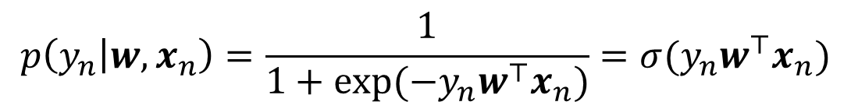
An Alternate Notation
If we assume the label $y_{n}$ as -1/+1 (not 0/1), the likelihood can be written as
Slightly more convenient notation: A single expression gives the probabilities of both possible label values
In this case, the total negative log-likelihood will be
$$p\left(y_{n} | w,x_{n}\right)=\frac{1}{1+exp(−y_{n}w^{⊤}x_{n})}=σ(y_{n}w^{⊤}x_{n})$$
$NLL\left(w\right)= \sum_{n=1}^{N}{−log p\left(y_{n} | w,x_{n}\right)=}$ $\sum_{n=1}^{N}{log (1+exp\left(−y_{n}w^{⊤}x_{n}\right))}$

Slide 6
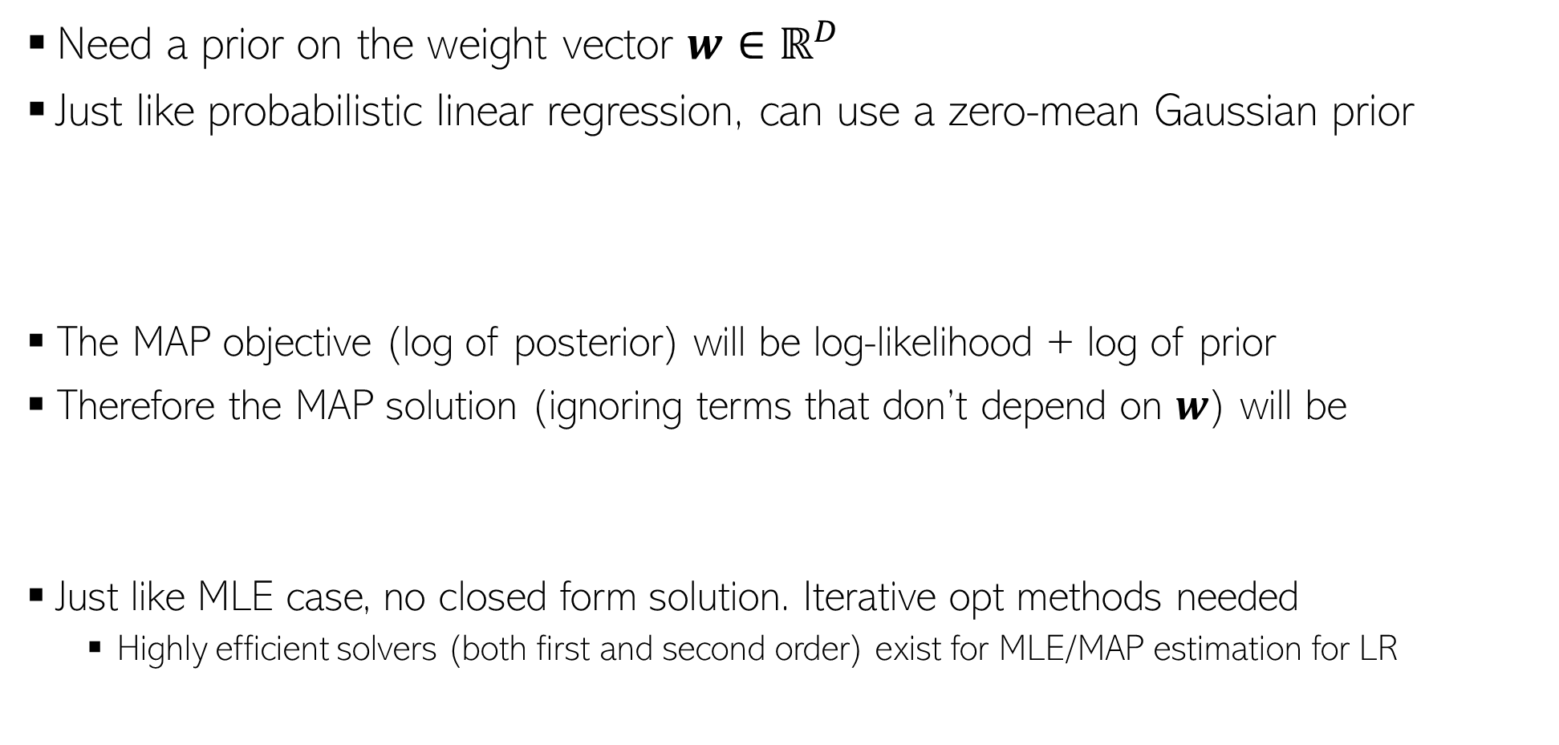
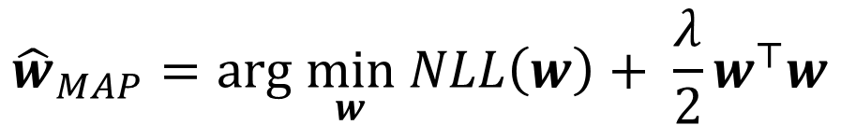
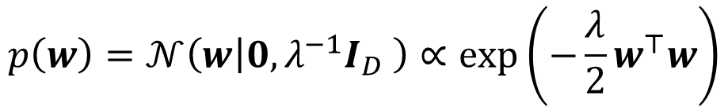
MAP Estimation for Logistic Regression
Need a prior on the weight vector $w∈ℝ^{D}$
Just like probabilistic linear regression, can use a zero-mean Gaussian prior
The MAP objective (log of posterior) will be log-likelihood + log of prior
Therefore the MAP solution (ignoring terms that don’t depend on $w$) will be
Just like MLE case, no closed form solution. Iterative opt methods needed
Highly efficient solvers (both first and second order) exist for MLE/MAP estimation for LR
$$p\left(w\right)=𝒩\left(w | 0,λ^{−1}I_{D} \right)∝exp\left(−\frac{λ}{2}w^{⊤}w\right)$$
Or NLL – log of prior
$${\hat{w}}_{MAP}=arg \min_{w} NLL\left(w\right)+ \frac{λ}{2}w^{⊤}w$$
Good news: convex objective

Slide 7
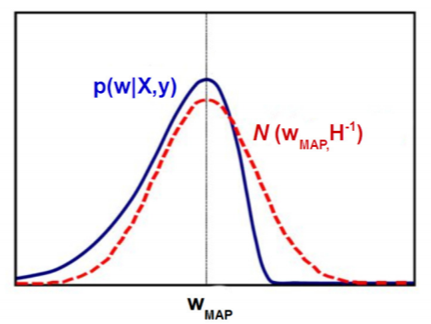
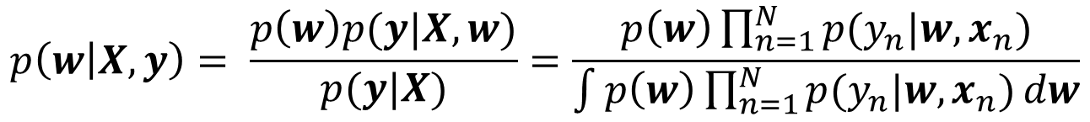
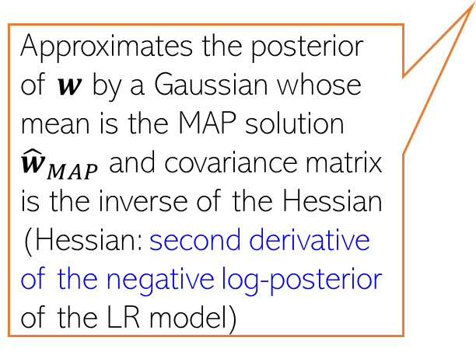
Fully Bayesian Inference for Logistic Regression
Doing fully Bayesian inference would require computing the posterior
Need to approximate the posterior in this case
We will use a simple approximation called Laplace approximation
Gaussian
Bernoulli
Unfortunately, Gaussian and Bernoulli are not conjugate with each other, so analytic expression for the posterior can’t be obtained unlike prob. linear regression
$$p\left(w | X,y\right)= \frac{p\left(w\right)p(y|X,w)}{p(y|X)}=\frac{p\left(w\right)\prod_{n=1}^{N}{p(y_{n}|w,x_{n})}}{\int{p\left(w\right)\prod_{n=1}^{N}{p(y_{n}|w,x_{n})}dw}}$$
Approximates the posterior of $w$ by a Gaussian whose mean is the MAP solution ${\hat{w}}_{MAP}$ and covariance matrix is the inverse of the Hessian (Hessian: second derivative of the negative log-posterior of the LR model)
Can also employ more advanced posterior approximation methods, like MCMC and variational inference (beyond the scope of CS771)

Slide 8
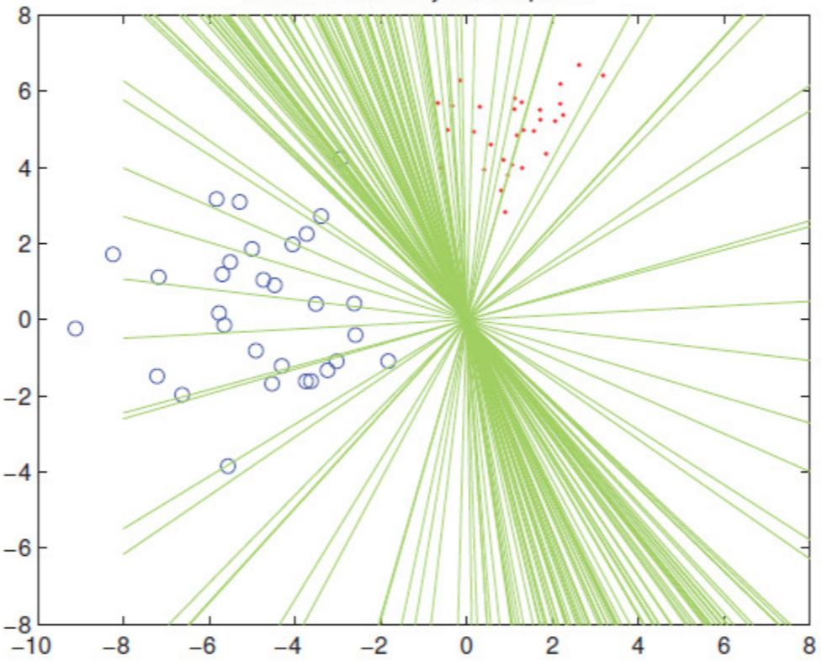
Posterior for LR: An Illustration
Can sample from the posterior of the LR model
Each sample will give a weight vec defining a hyperplane separator
Not all separators are equally good; their goodness depends on their posterior probabilities
When making predictions, we can still use all of them but weighted by their importance based on their posterior probabilities
That’s exactly what we do when computing the predictive distribution

Slide 9
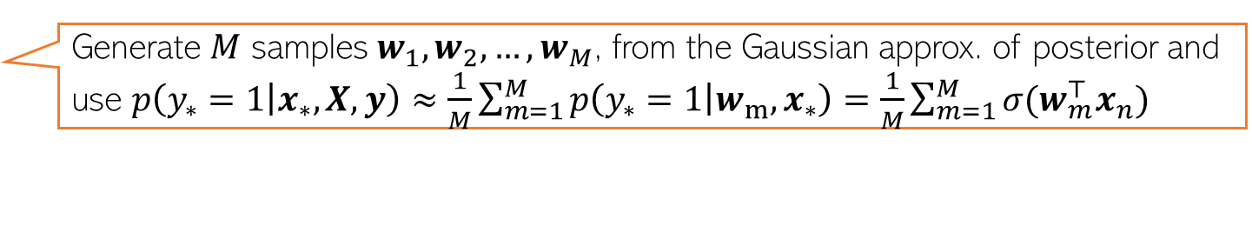

Logistic Regression: Predictive Distribution
When using MLE/MAP solution ${\hat{w}}_{opt}$, can use the plug-in predictive distribution
When using fully Bayesian inference, we must compute the posterior predictive
$p\left(y_{∗}=1 | x_{∗},X,y\right)=\int{p\left(y_{∗}=1 | {w,x}_{∗}\right)p\left(w | X,y\right)dw}$
$$≈p\left(y_{∗}=1 | {{\hat{w}}_{opt},x}_{∗}\right)=σ({{\hat{w}}_{opt}}^{⊤}x_{n})$$
$p\left(y_{∗} | x_{∗},X,y\right)=Bernoulli[σ({{\hat{w}}_{opt}}^{⊤}x_{n})]$
$p\left(y_{∗}=1 | x_{∗},X,y\right)=\int{p\left(y_{∗}=1 | {w,x}_{∗}\right)p\left(w | X,y\right)dw}$
Integral not tractable and must be approximated
sigmoid
Gaussian (if using Laplace approx.)
Monte-Carlo approximation of this integral is one possible way
Generate $M$ samples $w_{1}, w_{2}, …, w_{M}$, from the Gaussian approx. of posterior and use $p\left(y_{∗}=1 | x_{∗},X,y\right)≈\frac{1}{M}\sum_{m=1}^{M}{p\left(y_{∗}=1 | {w_{m},x}_{∗}\right)}=$ $\frac{1}{M}\sum_{m=1}^{M}{σ(w_{m}^{⊤}x_{n})}$

Slide 10
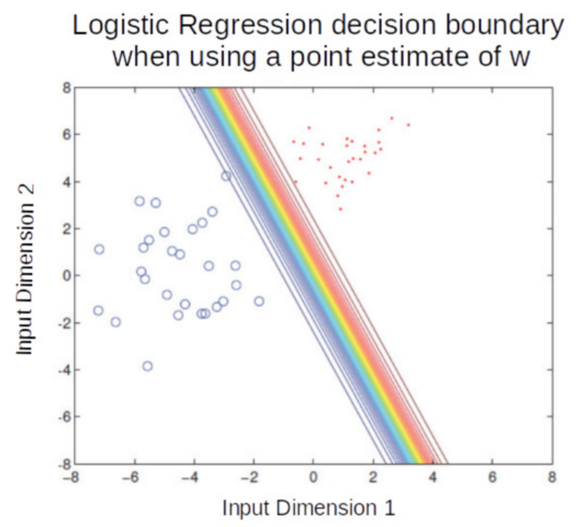
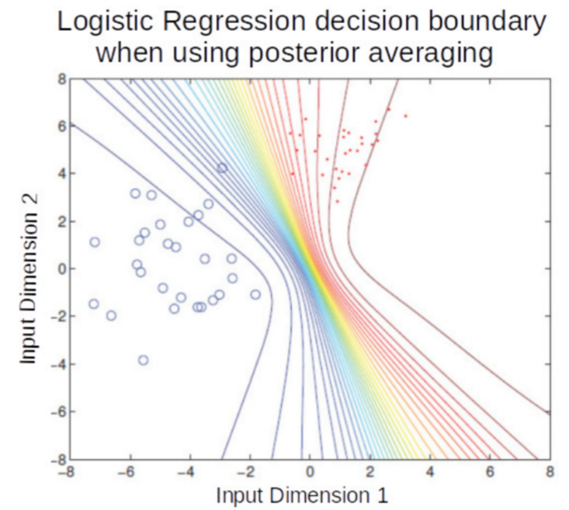
LR: Plug-in Prediction vs Postrerior Averaging
Posterior averaging is like using an ensemble of models. In this example, each model is a linear classifier but the ensemble-like effect resulted in nonlinear boundaries

Slide 11
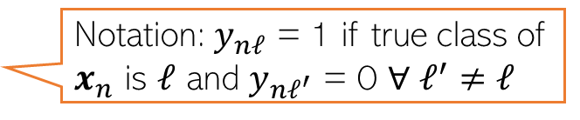
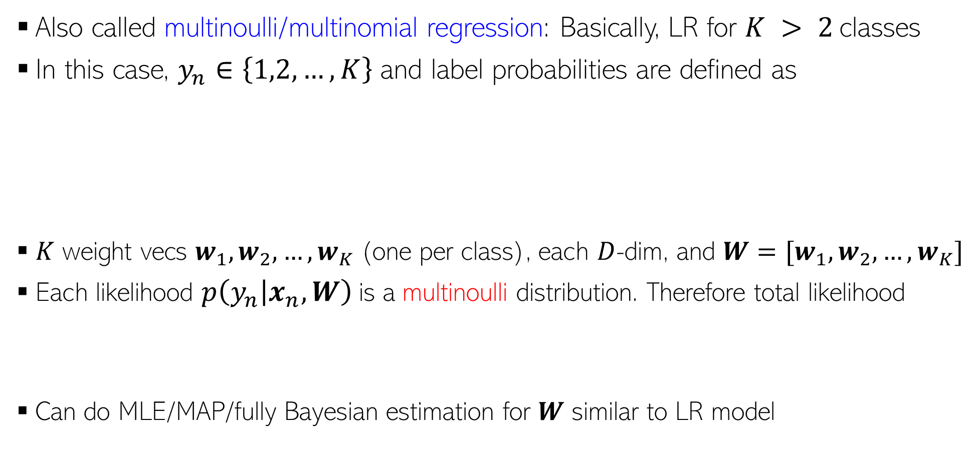
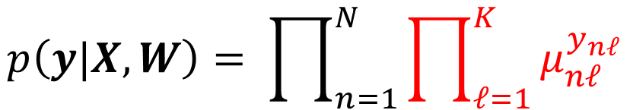
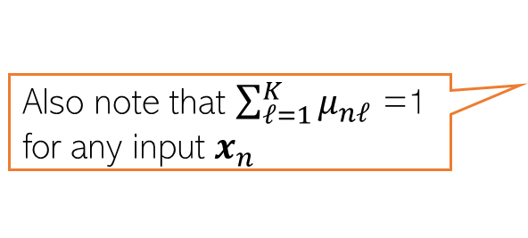
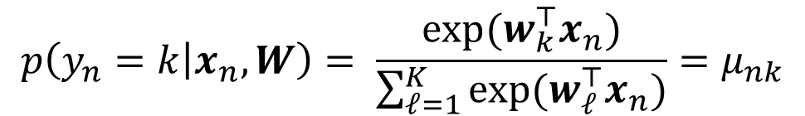
Multiclass Logistic (a.k.a. Softmax) Regression
Also called multinoulli/multinomial regression: Basically, LR for $K > 2$classes
In this case, $y_{n}∈\left\{1,2,…,K\right\}$ and label probabilities are defined as
$K$ weight vecs $w_{1},w_{2},…,w_{K}$(one per class), each $D$-dim, and $W=[w_{1},w_{2},…,w_{K}]$
Each likelihood $p\left(y_{n} | x_{n},W\right)$is a multinoulli distribution. Therefore total likelihood
Can do MLE/MAP/fully Bayesian estimation for $W$ similar to LR model
Softmax function
$$p\left(y_{n}=k | x_{n},W\right)= \frac{exp(w_{k}^{⊤}x_{n})}{\sum_{ℓ=1}^{K}{exp(w_{ℓ}^{⊤}x_{n})}}=μ_{nk}$$
Also note that $\sum_{ℓ=1}^{K}{μ_{nℓ}}$ =1 for any input $x_{n}$
$$p\left(y|X,W\right)= \prod_{n=1}^{N}{\prod_{ℓ=1}^{K}{μ_{nℓ}^{y_{nℓ}}}}$$
Notation: $y_{nℓ}$ = 1 if true class of $x_{n}$ is $ℓ$ and $y_{nℓ^{′}}$ = 0 $∀ ℓ^{′}$ $≠ℓ$

Slide 12
Coming up next
Generative models for supervised learning

